Slide 1
ELECRICAL CIRCUITS

Slide 2
ELECRICAL CIRCUITS
Before getting into electrical circuit its important to understand electrical terms.
  1. Voltage: Electrical pressure
  2. Current: Flow of electrons from one atom to another
  Resistance: the total opposition to current flow.

Slide 3
ELECRICAL CIRCUITS
Electrical circuits can be in one of 4 basic operating conditions.
  Operating normally: No excess resistance or current flow
12 volts
3 Ohms
4 Amps

Slide 4
ELECRICAL CIRCUITS
Short Circuit: In a short circuit current by-passes the load and finds a low resistance path to ground.
In a shorted circuit resistance drops to below 0 Amperage can increases to dangerous levels.
Point of Short

Slide 5
ELECRICAL CIRCUITS
Open Circuit: In an open circuit no current will flow.
Point of open
In this circuit the lamp will not illuminate because there is no complete pate for current to flow.

Slide 6
ELECRICAL CIRCUITS
Shorted to ground: A circuit shorted to ground will operate even when the control switch is opened.
In this circuit current will by-pass the switch
Point of ground

Slide 7
ELECRICAL OUIZ
1. Technician A says an electrical circuit that is grounded will not operate. Technician B says a grounded electrical circuit will operate continually. Who is correct?
  A. Technician A only B. Technician B only
  C. Both A and B D. Neither A nor B

Slide 8
ELECRICAL OUIZ
2. An electrical circuit that is open will:
A. Not allow current to flow
B. Allow current to flow
C. Have low resistance
D. Have high current flow

Slide 9
ELECRICAL OUIZ
3. A shorted circuit will have:
  A. No current flow
  B. Low current flow
  C. Normal current flow
  D. High Current flow

Slide 10
ELECRICAL OUIZ
4.In an electrical circuit voltage can be defined as:
  A. Electrical pressure
  B. Flow of electrons
  C. Opposition to current flow
  D. The amount of work a circuit can perform.

Slide 11
ELECRICAL OUIZ
5. A closed electrical circuit with normal resistance will:
  A. Operate normally
  B. Not operate
  C. Have higher than normal current flow
  D. Have no current flow

Slide 12
ELECRICAL CIRCUITS
The relationship between Voltage, Amperage and Resistance can be explained by using Ohms law.
Understanding Ohms Law is important for fast, accurate electrical problem diagnosis and repair.

Slide 13
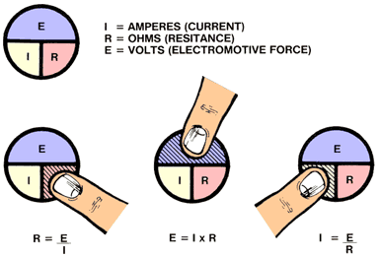
ELECRICAL CIRCUITS
By using the Ohms law symbols, anyone can remember the correct formula to use. By knowing any two values you can figure out the third. Simply put your finger over the portion of the symbol you are trying to figure out and you have your formula.

Slide 14
ELECRICAL CIRCUITS
Ohm's Law says:
Current in a circuit is directly proportional to the applied voltage
Current is inversely proportional to the amount circuit resistance.
This means that if the voltage goes up, the current flow will go up, and vice versa. Also, as the resistance goes up, the current goes down, and

Slide 15
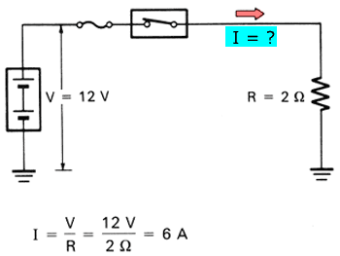
ELECRICAL CIRCUITS
In this circuit voltage source is 12 volts and resistance is 2 Ohms. What is total amperage.
I=E-/R
12 volts /2Ohms = 6 amps

Slide 16
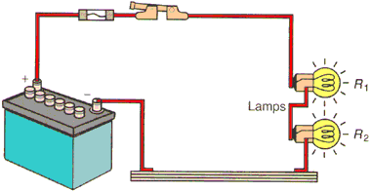
ELECRICAL CIRCUITS
A series circuit must have:
1. Power source (battery)
2. Electrical protection (Fuse)
3. Switch for control
4.Two load devices (lamps)
5. Conductors (wires)

Slide 17
ELECRICAL CIRCUITS
Power Source:
  Anything that supplies voltage and amperage to an electrical circuit.
    Battery
    Alternator
    Generator (used in earlier model vehicles)

Slide 18
ELECRICAL CIRCUITS
Electrical protection can be a
  Fuse
  Circuit breaker
  Fusible link wire
  Terminal limiters.

Slide 19
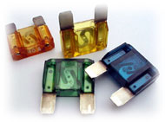
ELECRICAL CIRCUITS
A fuse is a device that is rated in amps and design for the circuit its being used in.
Never install a larger fuse than is recommended is any electrical circuit

Slide 20
ELECRICAL CIRCUITS
Installing a fuse that is larger than recommended by the manufacture can cause electrical fires.
The correct size fuse is determined by engineers. Some factor that is considered when determining fuse size is:
  Size load and amount of current it will require
  Wire size operating the load

Slide 21
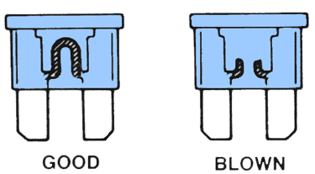
ELECRICAL CIRCUITS
A defective fuse can indicate an electrical short circuit. A short circuit exist when current bypasses the intended load and fines a low resistance path to ground

Slide 22
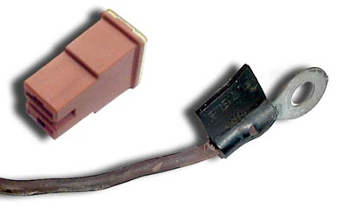
ELECRICAL CIRCUITS
Another type electrical protection device is fusible link wire.
Fusible link wire works similar to a fuse.
Most fusible link wire is used with circuit that require 30 Amps or more.

Slide 23
ELECRICAL CIRCUITS
Never replace fusible link wire with regular electrical wire.
Fusible link wire will open internally without burning the outer insulation.

Slide 24
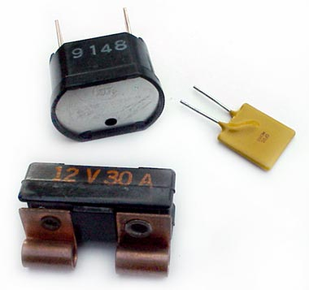
ELECRICAL CIRCUITS
Circuit Breakers are used when total circuit failure could be dangerous to the operator,
  Headlights
  Power windows
  Sun roofs

Slide 25
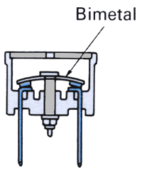
ELECRICAL CIRCUITS
CIRCUIT BREAKER OPERATION (MANUAL TYPE)
The circuit breaker contains a metal strip made of two different metals bonded together called a bimetal strip.
When excesses current/heat is applied the medal strip will separate opening the circuit preventing current flow

Slide 26
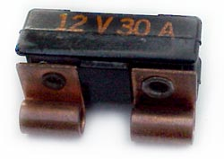
ELECRICAL CIRCUITS
Automatic resetting circuit breaker will reset after current flow is lower and the bi-medal strip cools.

Slide 27
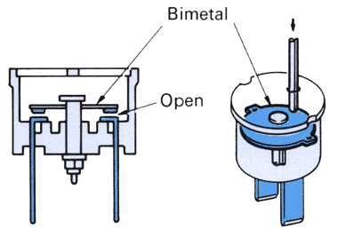
ELECRICAL CIRCUITS
A manual reset type circuit breaker can be reset by using a small medal rod or paper clip through a small hold in top of the circuit breaker

Slide 28
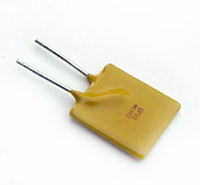
ELECRICAL CIRCUITS
Solid State circuit breaker have no moving parts an are used to protected high current circuit such as power windows and sun roofs.

Slide 29
ELECRICAL CIRCUITS
SOLID STATE TYPE Circuit Breakers PTC
A PTC (Positive Coefficient) therministor) increases resistance as its temperature is increased.
After cooling current will again be allowed to flow.

Slide 30
ELECRICAL CIRCUITS
Circuit breakers work similar to a fuse except they can be reset either mechanically or automatically
Circuit breakers are normally located inside the fuse box, However some circuit such as headlights and power windows can have circuit breaker built into the switch or motor.

Slide 31
ELECRICAL CIRCUITS
Circuit breaker are normally used to protect:
  Low voltage circuits
  High Voltage circuit
  Low amperage circuits
  High amperage circuits

Slide 32
ELECRICAL CIRCUITS
2. Technician A says: When a manually reset circuit breaker is closed current will not flow. Technician B says: A manually operated circuit breaker can be reset using a small medal rod or paper clip. Who is correct?
A. Technician A C. Both A and
B. Technician B D. Neither A nor B

Slide 33
ELECRICAL CIRCUITS
3. An electrical fire can be caused by a:
  A. Short circuit
  B. Open circuit
  C. Closed circuit
  D. All the above

Slide 34
ELECRICAL CIRCUITS
4. Voltage can be best described as the:
  A. Opposition to current flow
  B. Flow of electrons from one atom to another
  C. Electrical pressure
  D. The amount of work a circuit can perform.

Slide 35
ELECRICAL CIRCUITS
5. Technician A says solid state circuit breaker how no moving parts. Technician B says solid state circuit breaker will close when current flow is excessive. Who is correct?
  A. Technician A only
  B. Technician B only
  C. Both Technician A and B
  D. Neither A nor B

Slide 36
ELECRICAL CIRCUITS
6. Technician A says: When replacing a fusible link wire use 4 sizes smaller wire. Technician B says when replacing a fuse always check for electrical shorts. Who is correct?
  A. Technician A only
  B. Technician B only
  C. Both A and B
  D. Neither A nor B

Slide 37
ELECRICAL CIRCUITS
7. Electrical shorts:
  A. Pull to much amperage
  B. Pull to little amperage
  C. Are caused by high resistance
  D. Are caused by low current flow.

Slide 38
ELECRICAL CIRCUITS
8. A series circuit has:
  A. Several path for current to flow
  B. The most voltage drop at the point of most resistance
  C. Current flow when the circuit is open
  D. Has one path for current to flow

Slide 39
ELECRICAL CIRCUITS
9. Ohms law states that voltage can be determined by:
  A. E = I / R
  B. E = R / I
  C. E = P x I
  D. E= I x R

Slide 40
ELECRICAL CIRCUITS
10. Resistance is:
  A. Flow of electrons
  B. Electrical pressure
  C. Opposition to current flow
  D. All the above.

Slide 41
ELECRICAL CIRCUITS
Electrical circuits must be controlled. Several type switches, relays, sensors and electronic components can be used to control and electrical circuit.
Switches (control devices) can be used to start, stop and redirect current flow in and electrical circuit.

Slide 42
ELECRICAL CIRCUITS
Switches are the most common type of circuit control device.
  Single pole single throw (SPST)
  Double pole double throw (DPDT)
  Multi pole multi throw (MPMT)
  Bi-medal temperature
  Mercury
  Momentary open or close

Slide 43
ELECRICAL CIRCUITS
Switches are described by the number of poles and throws they control.
A pole is a switch input terminal
A throw is a switch output terminal

Slide 44
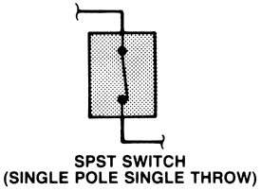
ELECRICAL CIRCUITS
This is a single pole single throw switch.
Input
Output

Slide 45
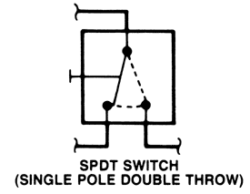
ELECRICAL CIRCUITS
Input
Single pole double throw switch SPDT switch
One input and two outputs.
Output
Output

Slide 46
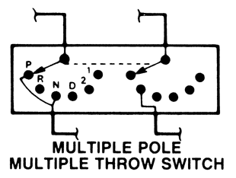
ELECRICAL CIRCUITS
A multiple pole multi throw switch has several inputs and outputs.
Multi pole switches can be very complex compared to other type switches.

Slide 47
ELECRICAL CIRCUITS
Momentary switch normally open. Used as brake light switch
Momentary switch normally closed. Used in cruse control system

Slide 48
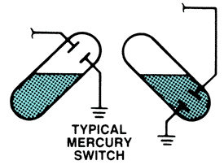
ELECRICAL CIRCUITS
A mercury switch is made using a sealed capsule partially filled with mercury.
Mercury is used to complete electrical contact allowing current to flow.

Slide 49
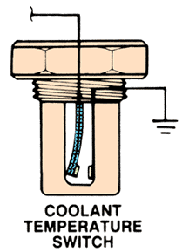
ELECRICAL CIRCUITS
A bi-medal switch will closes when hot allowing current to flow.
Bi-medal switch can be used to control cooling fan or temperature indicator light.

Slide 50
ELECRICAL CIRCUITS
Another type switch is a relay. A relay uses a small amount of current to control a large amount of current flow.
Relays can be either normally open or normally closed.
Relay construction contains an iron core, electromagnetic coil, and an armature (moveable contact set).

Slide 51
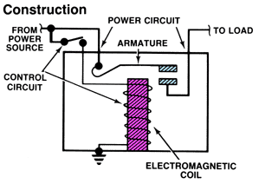
ELECRICAL CIRCUITS
This is a normally open relay.
Most automotive relays are numbered
12 volts
30
Control Voltage
86
87
Load
85

Slide 52
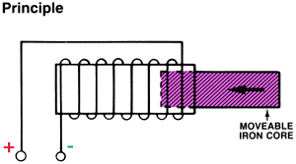
ELECRICAL CIRCUITS
Solenoids: Operate similar to relays.
Relays controls electrical current
Solenoid controls electrical movement.

Slide 53
ELECRICAL OUIZ
1. A Bi-medal switch is can be used to control:
  A. Headlights
  B. Back-up lights
  C. Cooling fans
  D. Brake lights

Slide 54
ELECRICAL OUIZ
2. Technician A says relays control a mechanical output. Technician B says relays are used to control an electrical output. Who is correct?
  A. Technician A only
  B. Technician B only
  C. Both A and B
  D. Neither A nor B

Slide 55
ELECRICAL OUIZ
3. A solenoid controls:
  A. Electrical current
  B. Electrical pressure
  C. Resistance
  D. Mechanical movement

Slide 56
ELECRICAL OUIZ
4. What type switch is this?
  A. SPST
  B. SPBT
  C. SPMT
  D. DPDT

Slide 57
ELECRICAL OUIZ
5. What type switch is this?
  A. SPST
  B. DPST
  C. SPDT
  D. MPMT

Slide 58
ELECRICAL OUIZ
6. Technician A says a switch pole is an input. Technician B says a switch pole is an output. Who is correct?
  A. Technician A only
  B. Technician B only
  C. Neither A nor B
  D. Both A and B

Slide 59
ELECRICAL OUIZ
7. Technician A says a throw is and electrical output. Technician B says a switch throw is an electrical output. Who is correct?
  A. Technician A only
  B. Technician B only
  C. Both A and B
  D. Neither A nor B

Slide 60
ELECRICAL OUIZ
8. What type electrical switch is this?
  A. SPST
  B. Momentary Switch
  C. Bi-medal Switch
  D. SPBT

Slide 61
9. Is this relay normally open or normally closed?
A. Closed
B. Open
C. Neither
D. Dose not apply

Slide 62
Electrical Quiz
10. A open electrical switch will:
A. Not allow current to flow
B. Have high resistance
C. Have low resistance
D. Both A and B

Slide 63
Electrical Circuits
Modern automobiles have several different electrical circuits.
Before a technician can effectively repair any vehicle he must first be able to understand electrical diagrams.

Slide 64
Electrical Circuits
Most electrical diagram are read top to bottom.
When using wiring diagrams its important to understand the symbols used by automotive manufactures.

Slide 65
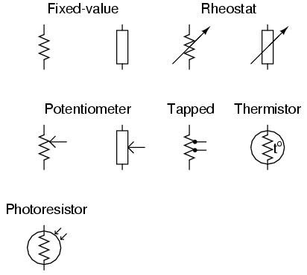
Electrical Circuits

Slide 66
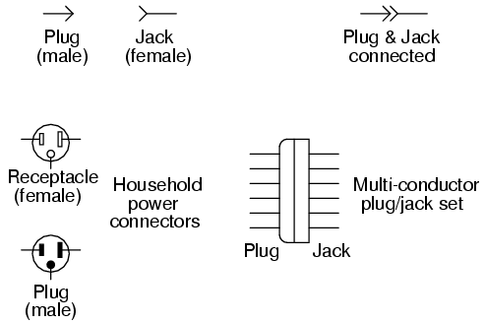
Electrical Circuits
1. These are common electrical connector
2. Always refer to proper vehicle service manual when working with electrical symbols

Slide 67
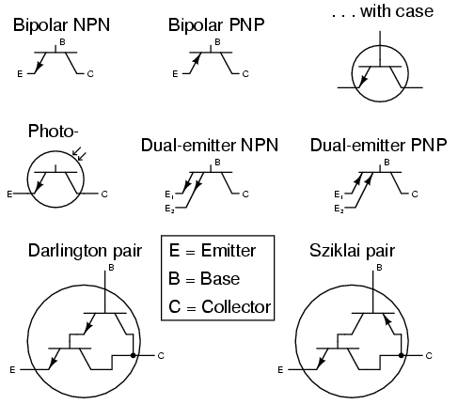
1. These are common transistor symbols.
2. Transistor can be used as switches or amplifiers
3. Most automotive transistor are not serviceable in the field. But an understanding is extremely important to properly understand and diagnose most automotive systems.

Slide 68
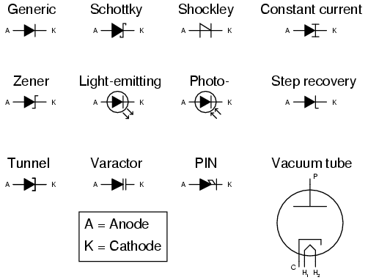
Electrical Circuits

Slide 69
Electrical Circuits

Slide 70
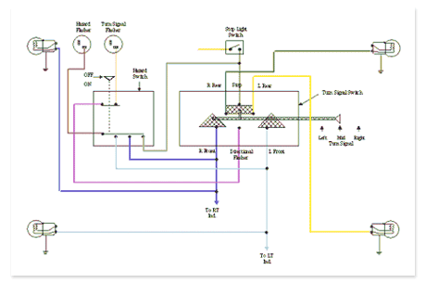
Electrical Circuits

